Slide 1
How to use the
Barbour Content tab

Slide 2
Index
Log into your account
Homepage
Explore content
Topics
Explore topics
Topic overview
Available resources
Types of content
Publishers

Slide 3
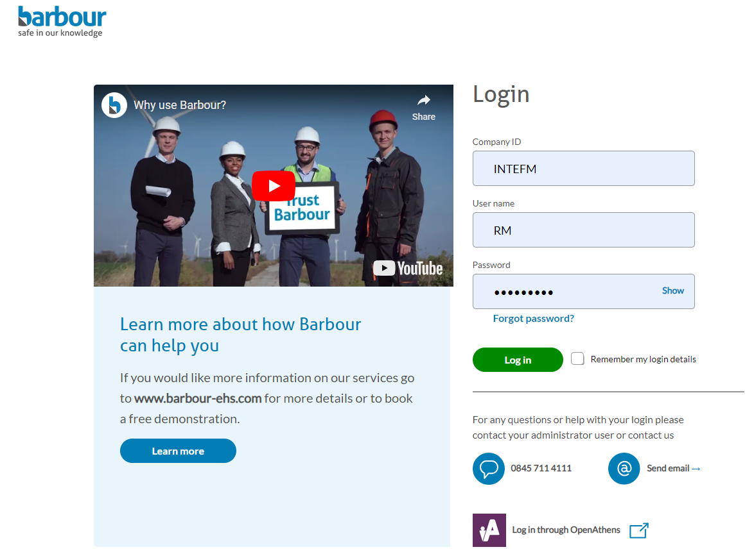
Log into your account
Login into your account through our home page.

Slide 4
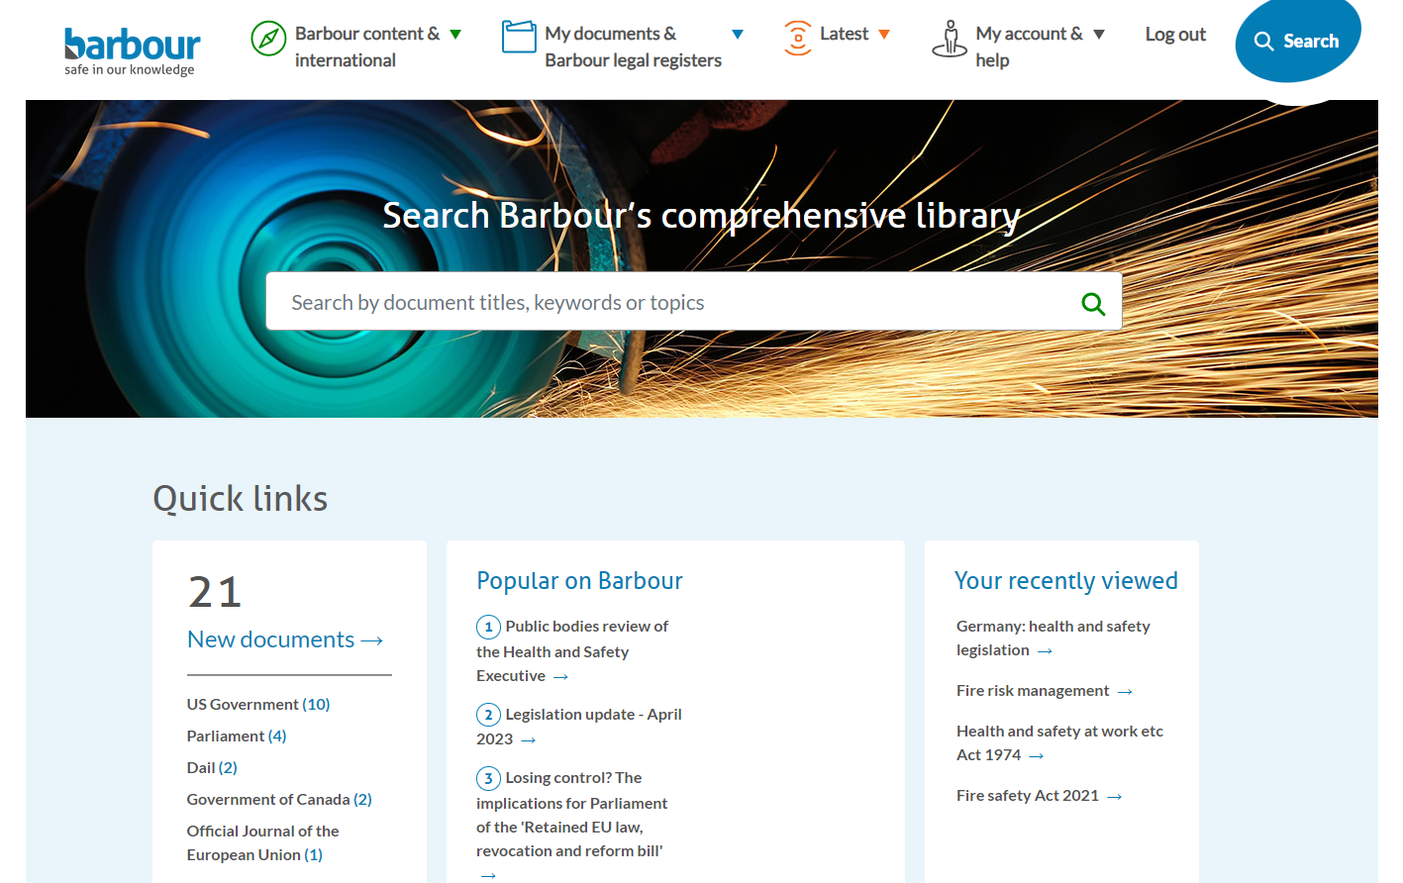
Homepage

Slide 5
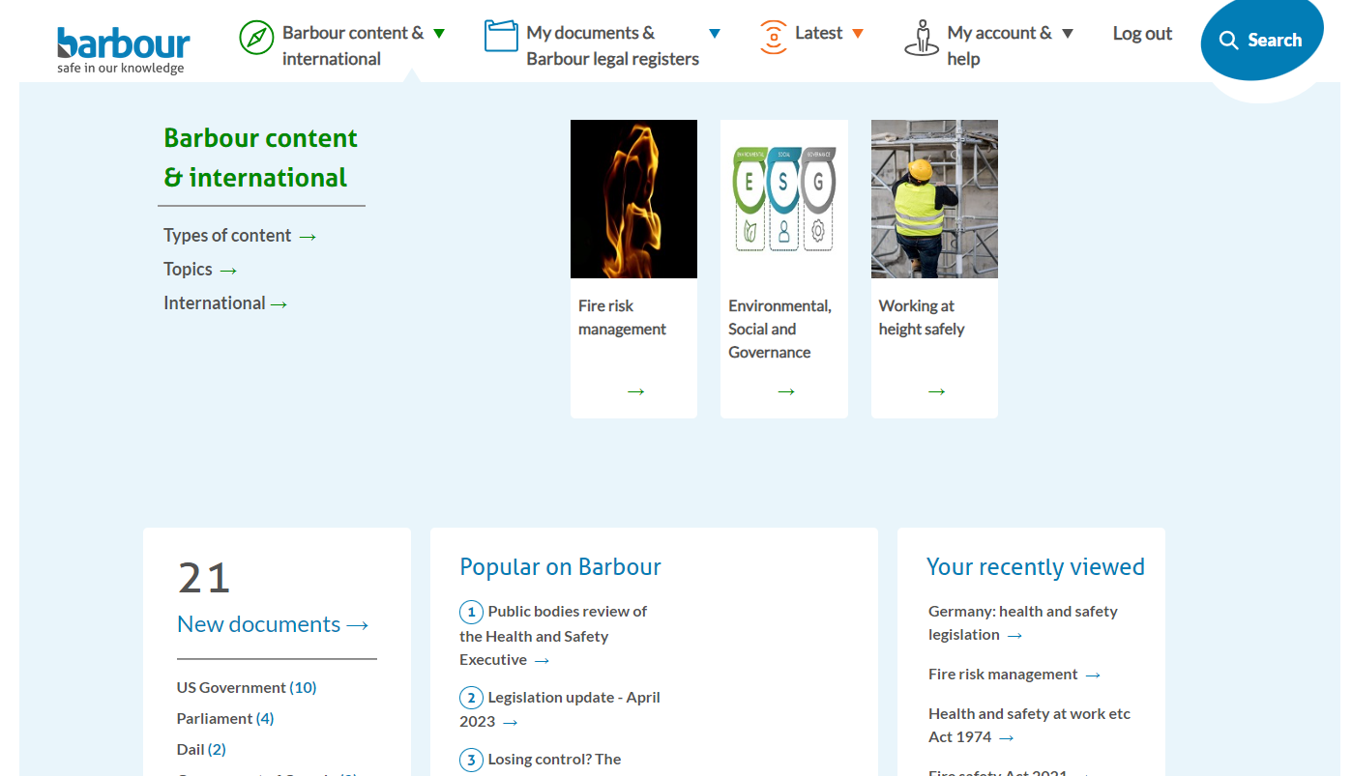
Explore content
The Barbour Content tab contains all the information within the Barbour library that we have grouped together under individual topics, so you have quick access.

Slide 6
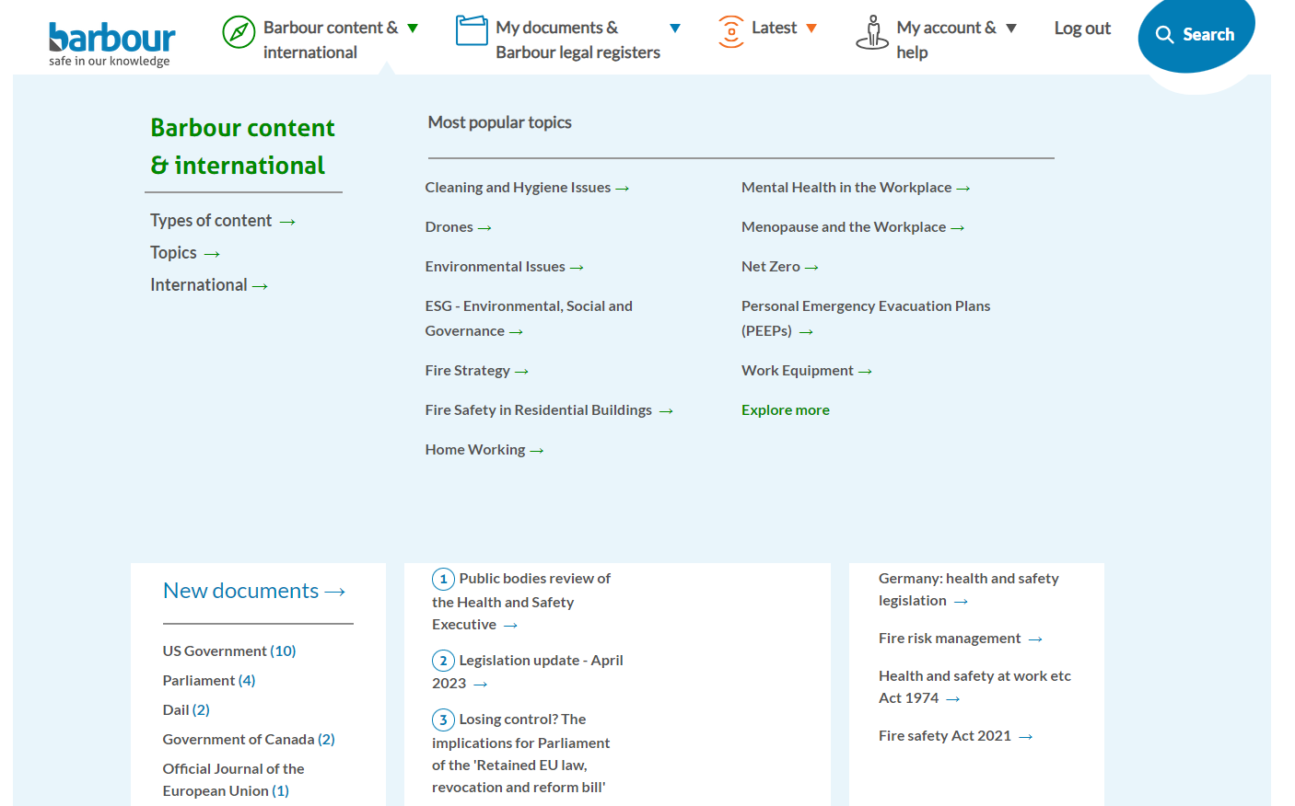
Explore content - Topics
You can search the library by topics. By hovering over Topics, the most popular subjects that people are looking at will be displayed.
You can also click Explore more to see the full A-Z topic list.

Slide 7
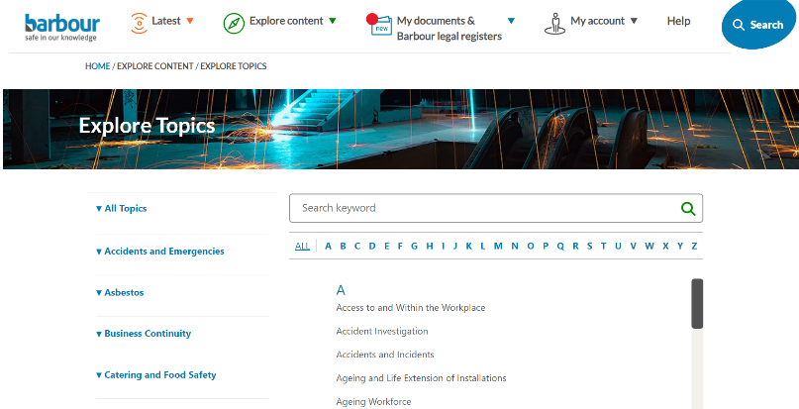
Explore content – Explore topics
You can use the full A-Z list in three different ways…

Slide 8
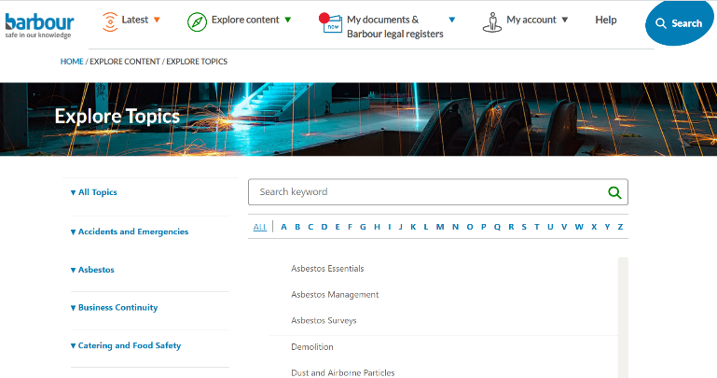
Explore content – Explore topics
1) Use click on the headings in the left-hand side menu. This will display the subtitles within those topic areas.

Slide 9
Explore content – Explore topics
2) Select a letter at the top of the page to narrow down your search
Tip: Please ensure that ‘All Topics’ is selected on the left-hand side

Slide 10
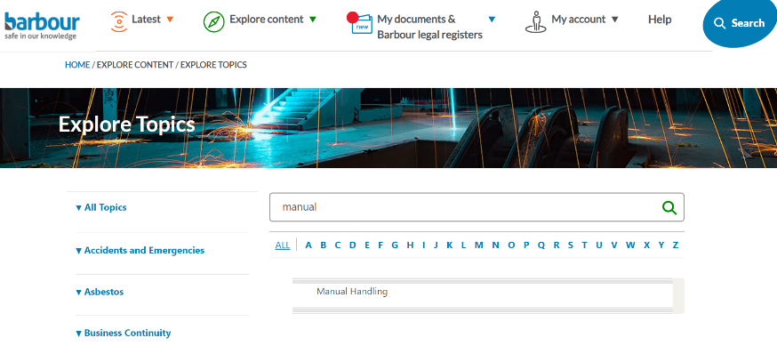
Explore content – Explore topics
3) You can use the search bar at the top of the page to search for your topic.

Slide 11
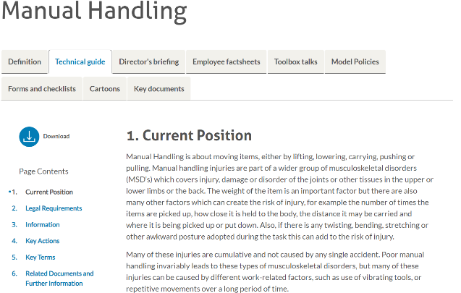
Explore content – Topic Overview
Once you have found your chosen topic, click it and you will be taken to the topic overview page. Here, you will find a summary of the topic along with other ready-made resources that you can use.

Slide 12
Explore content – Available resources
Some of the resources available to you are:
Directors Briefings: short handouts to help your managers and senior teams Employee Factsheets: concise handouts covering your employees’ responsibilities
Toolbox talks: PowerPoint presentations that enable you to create training sessions

Slide 13
Explore content – Available resources
Other resources include Model Policies and Forms and Checklists to save you from researching, interpreting, writing and updating your own.

Slide 14
Explore content – Available resources
Key Documents brings all legislation, guidance, documents and information about that topic into one handy tab.

Slide 15
Explore content – Types of content
You can search the library by Types of content. This gives you a full A-Z list of types of content within the Barbour library. To see them all, click on Explore more.

Slide 16
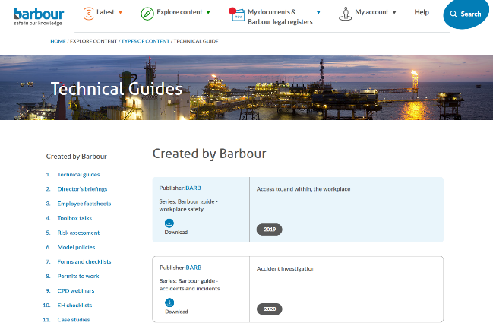
Explore content – Types of content
By selecting Technical Guides, you will be taken to an A-Z list of all the technical guides within the Barbour library. If you wish to view another content type, you can use the quick menu on the left.

Slide 17
Explore content – Publishers
You can search the library by Publishers. You will initially see the most popular publisher on the Barbour site but can click Explore more to see the full list.

Slide 18
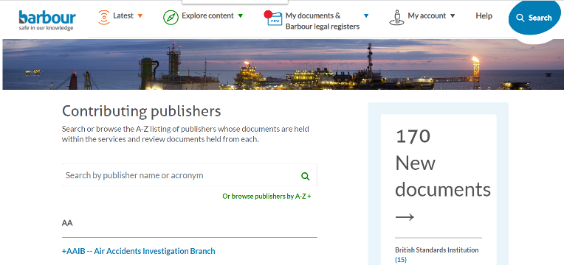
Explore content – Publishers
You can use the search bar at the top to look for your publisher of choice, or scroll through the page.

Slide 19
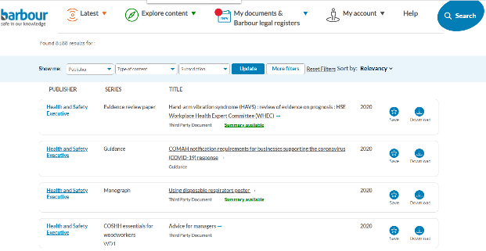
Explore content – Publishers
Once you have found your chosen publisher, you will see their contact details. By clicking See document, you can view all of the documents within our library produced by that publisher. This total number can be seen at the top of the page.

Slide 20
Thank you
If you would like any further assistance, please get in touch:
help@barbour-ehs.com
0845 711 4111

